Slide 1
MEME’s REstaurant
GROUP MEMBERS:
ARVIN LEONARD BOQUIREN
JOSHUA BAUTISTA
JESSIE VICTOR GOLOSO
KEVIN RONN VILLEGAS
JOHN KENNETH ROY

Slide 2
Background of the Study
Meme’s Restaurant website is an advertisement website that plans to give the user information about the restaurant , like restaurant hours and location.
It also plans to give the user information about the product , like product description , how the product is being prepared and the price of the product.

Slide 3
Importance of the Study
It will give the restaurant more popularity because of the advertisement given by the website
It will give the user information about the restaurant and it’s product
The user will learn how to prepare the food they wanted

Slide 4
Statement of the Problem
The restaurant is not popular to the customers
The restaurant don’t have enough advertisement
The customers don’t know what are the foods they are serving
The customers don’t know the location of the restaurant
The customers don’t know if they are available
Notes:
The study aims to answer the following questions:

Slide 5
Objectives of the Study
To give the restaurant more customers
To give the restaurant more popularity
To make the customers interested to the restaurant
To give customers information about the restaurant and it’s products

Slide 6
Scope and Delimitation
The scope of our website is to give information to the user about the restaurant and it’s products.
The delimitation of our website is it can’t be use to order the product online.

Slide 7
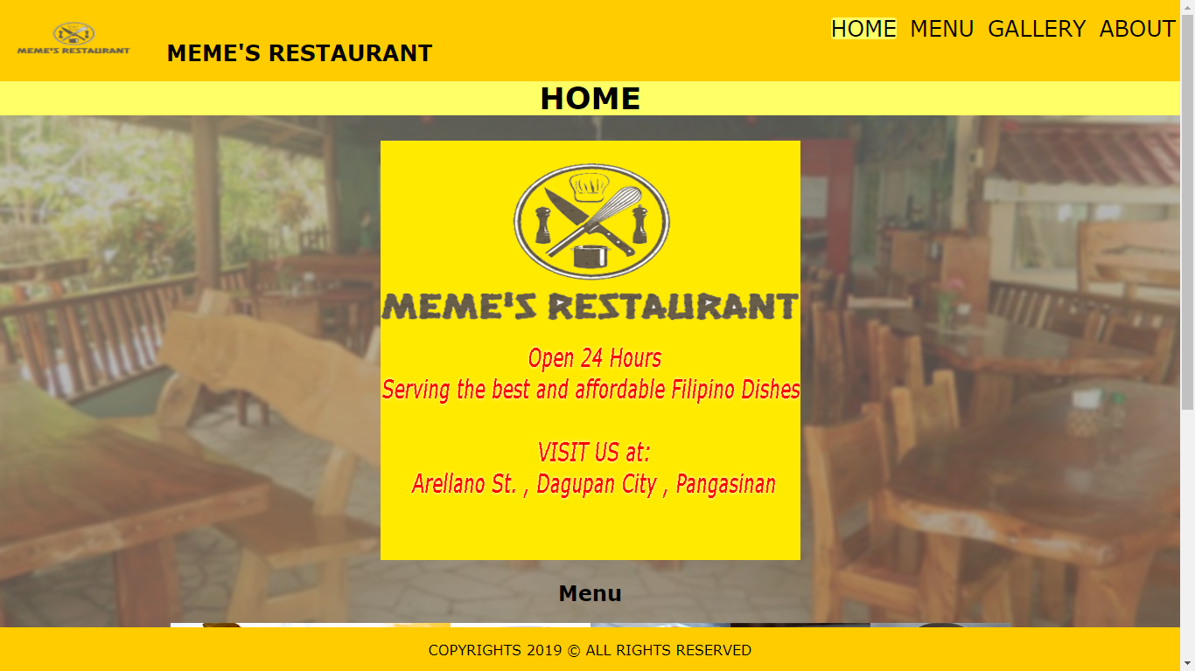
Features of the Website
Home page

Slide 8
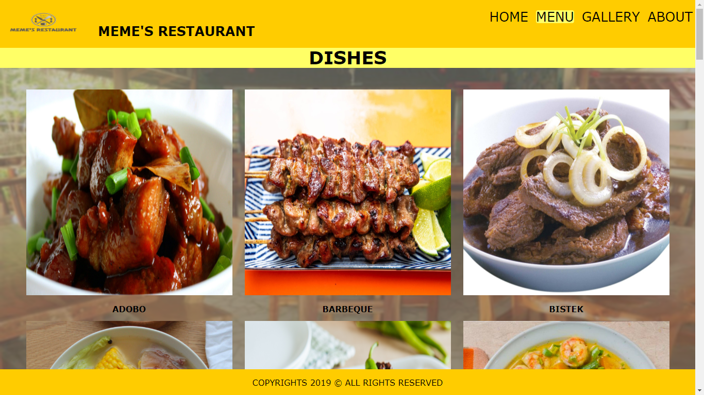
Menu

Slide 9
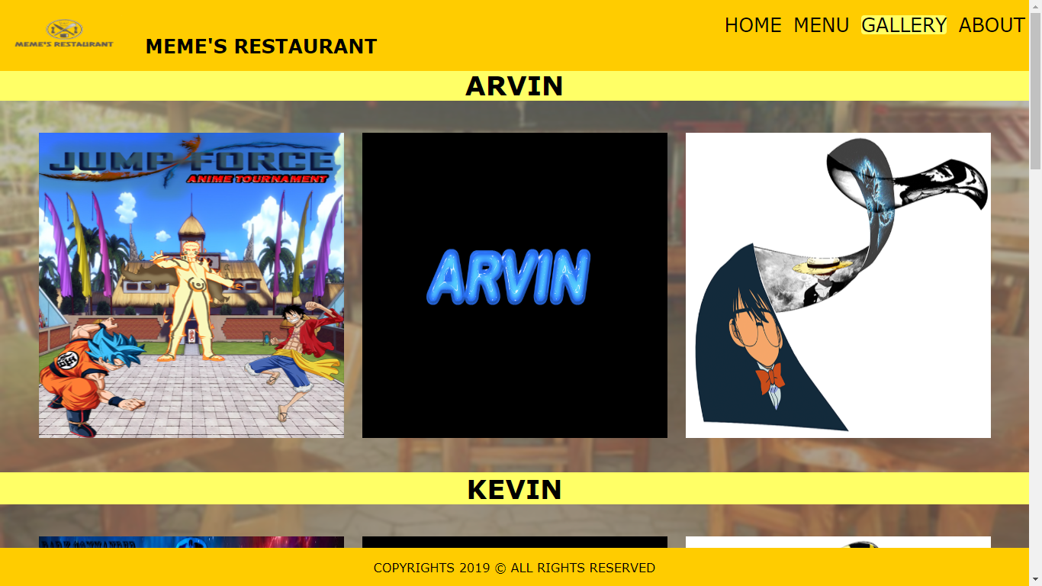
Gallery

Slide 10
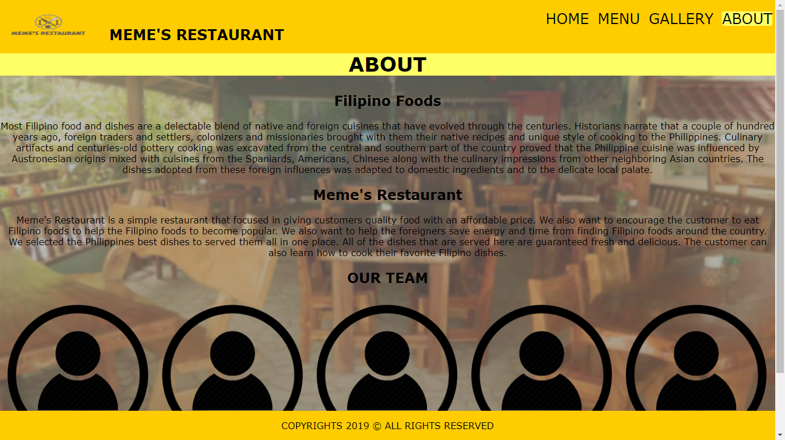
About

Slide 11
Conclusion and Recommendation
We concluded that using website as an advertisement is a good way to increase the popularity and customer of a business.
Our recommendation is to make an advertisement website to improve the popularity and the number of customers of a business

Slide 12
Thank you!

